Slide 1
Custom connectors
Prepared by Anton Sobolevsky,
Power platform developer

Slide 2
Agenda
1. Overview of custom connectors
2. Authentication types (No authentication, Basic authentication, Api Key based authentication, Oauth 2.0)
3. Create a Custom connector from an OpenAPI Definition (Swagger file)/Import a Postman collection
4. PostMan (Test RESTful APIs, HTTP response status codes)
5. Custom connector triggers (webhook/polling)
6. Custom connector actions (Path, Query, Headers, Body), fields Visibility (None,Advanced,Internal,Important)
6. Swagger Editor, Policies
7. Test and share a custom connector
8. Certify custom connector (optional)

Slide 3
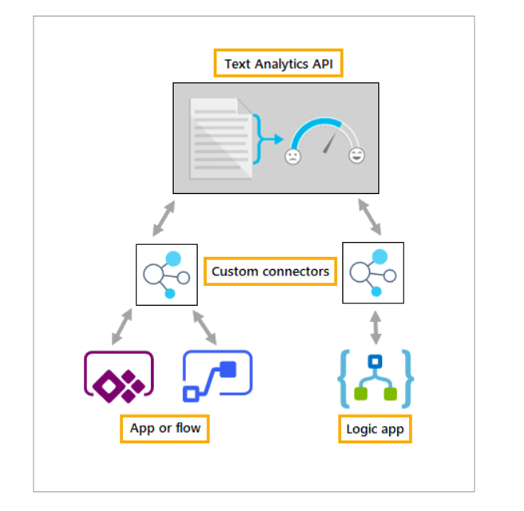
Overview of custom connectors
Connector components
Actions
Triggers
325+ connectors currently available to
connect to Microsoft and non-Microsoft services

Slide 4
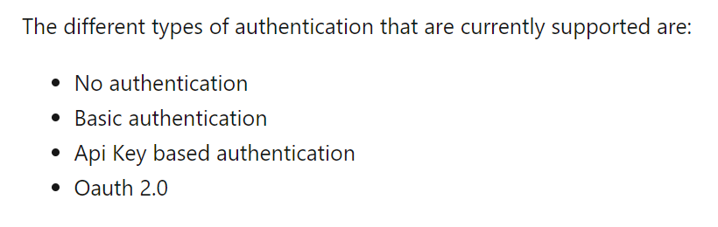
Authentication types

Slide 5
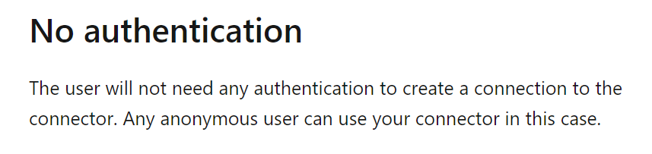
No authentication

Slide 6
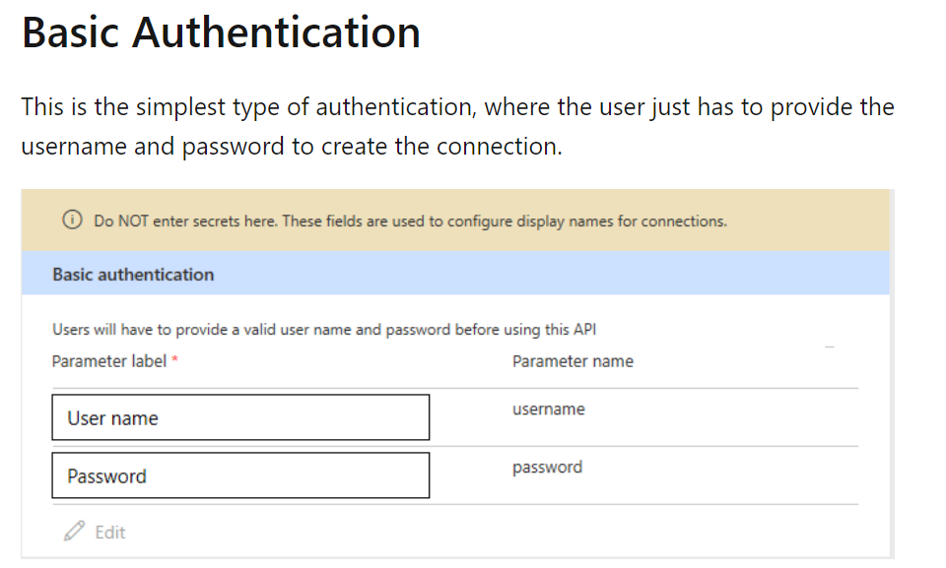
Basic Authentication

Slide 7
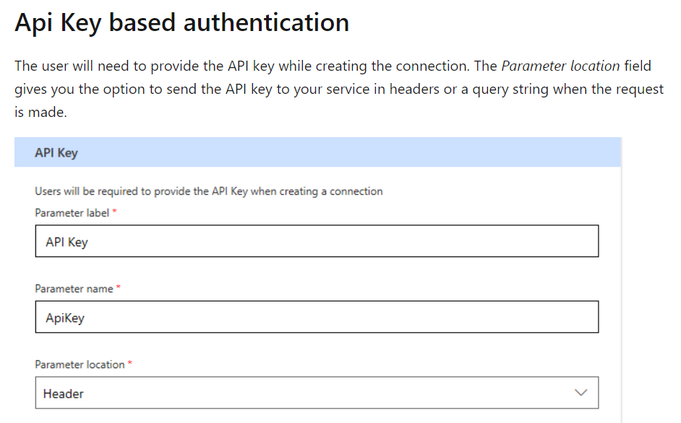
Api Key based authentication

Slide 8
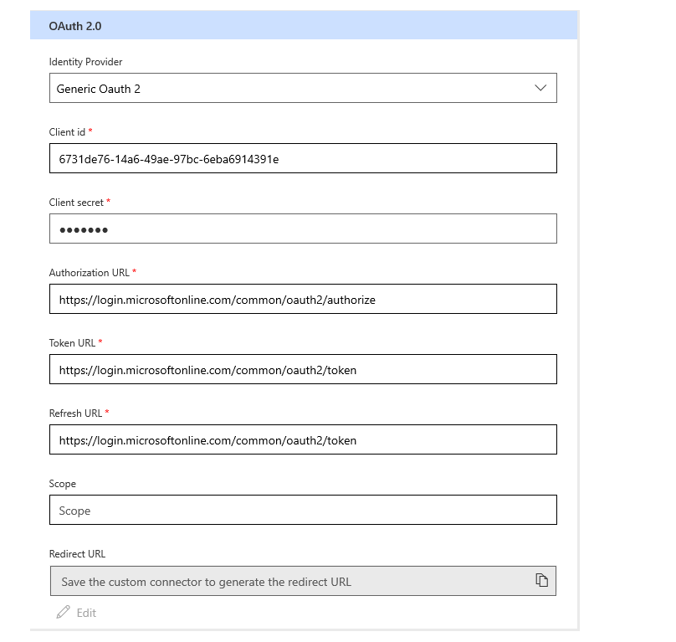
Oauth 2.0
Requires action:
a) Register the application in Azure AD
b) Create client secret

Slide 9
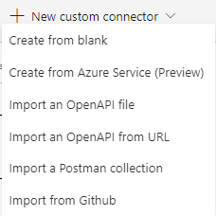

Possible ways to create custom connector
If you use an OpenAPI definition or Postman collection to describe a custom connector, the file must be less than 1 MB.

Slide 10
Import an OpenAPI file
(Demonstration)

Slide 11

Import a Postman collection
(Demonstration)

Slide 12
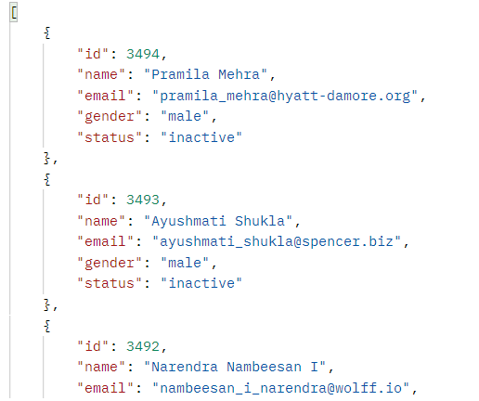
Path, Query, Headers, Body
Path – wrap your parameter in curly braces - {ID}
Example: https://gorest.co.in/public/v2/users/{1}
Query – everything after “?”
Example: https://gorest.co.in/public/v2/users?id=1
Example: https://gorest.co.in/public/v2/users?gender=male
Example: https://aggreko-stg.saasiteu.com/api/odata/
businessobject/servicereqs?$filter=
CreatedDateTime gt 2022-03-05T23:42:48Z&$top=100
?gender=male

Slide 13
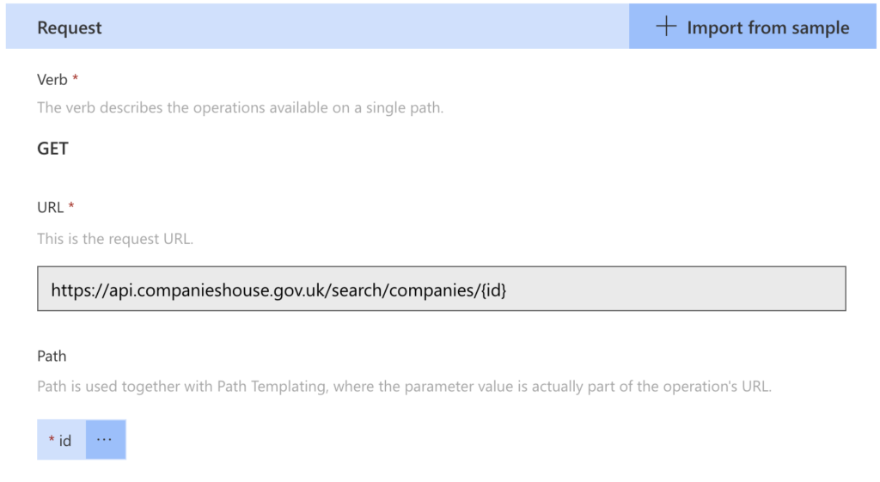
Path

Slide 14
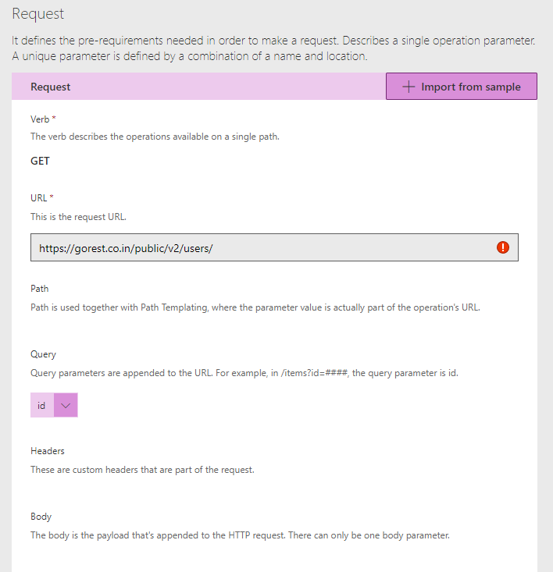
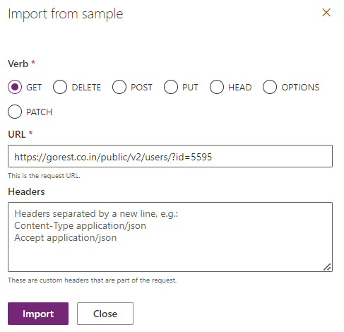
Query

Slide 15
Fields visibility
Important - operations and parameters are always shown to the user first.
Advanced - operations and parameters are hidden under an additional menu.
Internal - operations and parameters are hidden from the user.

Slide 16
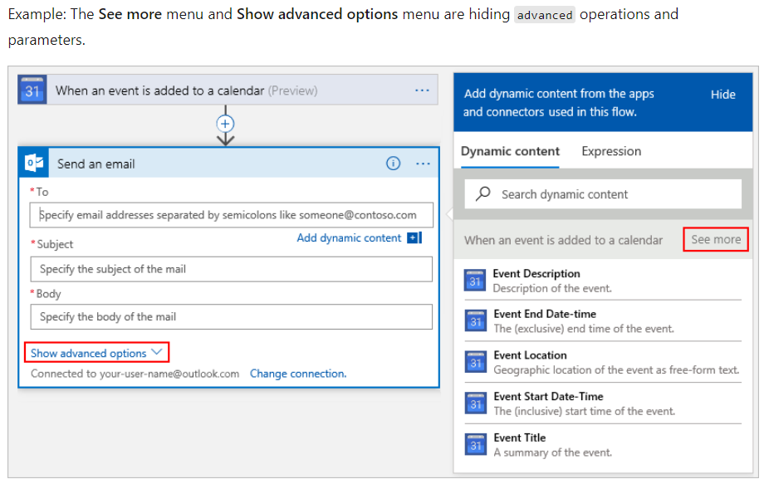
Example ‘Advanced’

Slide 17
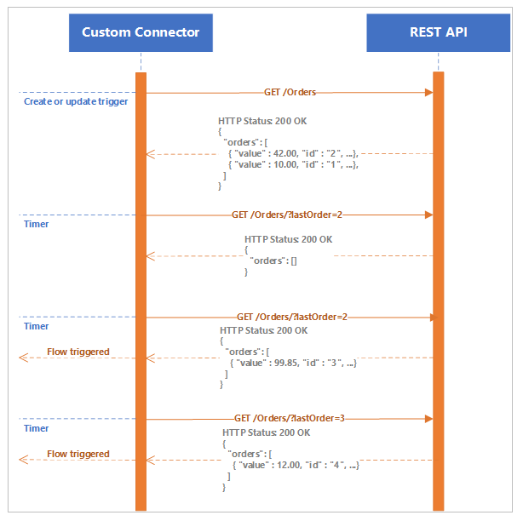
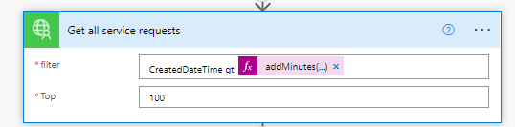
Polling trigger
A polling trigger is an implementation that
regularly calls your REST API service and
checks for new data.
addMinutes(utcNow(), -120, 'yyyy-MM-ddThh:mm:ssZ')

Slide 18
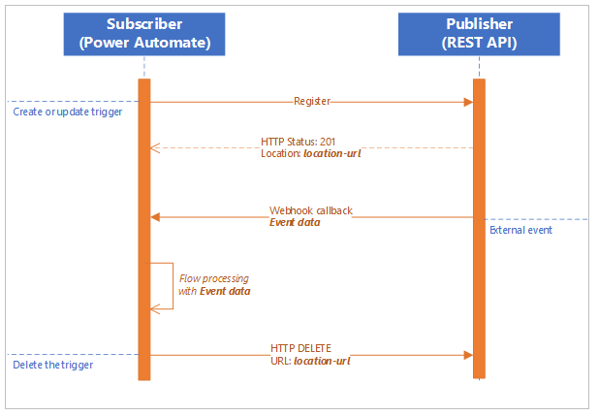
Webhook trigger
API requirements
To provide webhook support that is required by custom connectors, the API implementation must provide the following parameters:
An endpoint that accepts the registration and returns location information
A definition of the message body that is sent with the notification messages
An endpoint to accept DELETE message to remove webhook registration

Slide 19
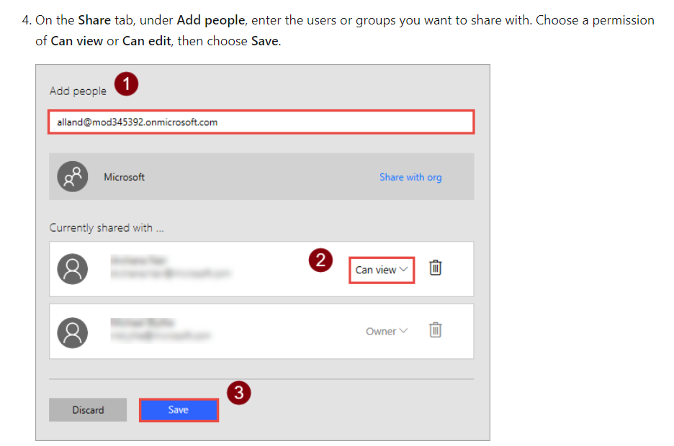
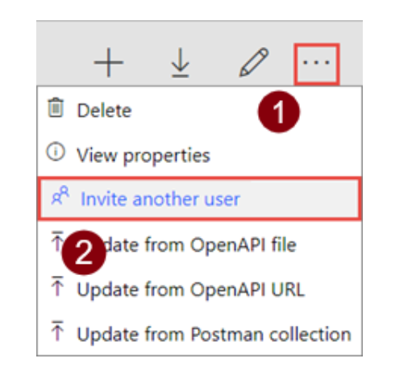
Share a custom connector

Slide 20
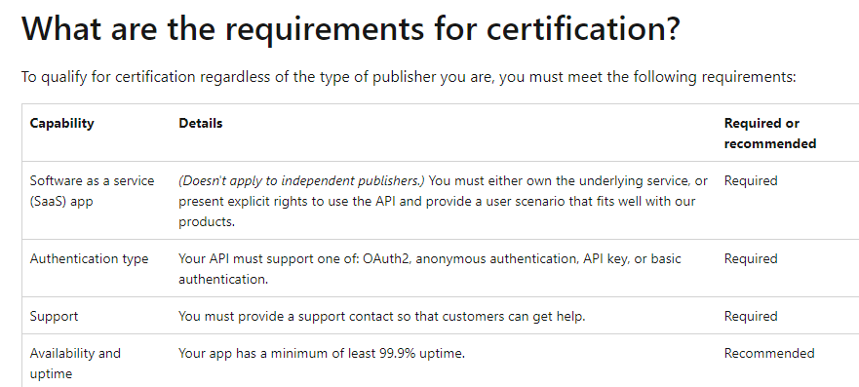
Certify custom connector (optional)
To make a custom connector publicly available for all users in Logic Apps, Power Automate, and Power Apps, submit your connector to Microsoft for certification. Microsoft will review the connector and, if it meets certification criteria, approve it for publishing.

Slide 21


